Slide 1
UNIT 5 (File Organization)
Java I/O Classes and interfaces

Slide 2
Unit VI : Topics
File Handling and Organization in Java
Java I/O Classes and interfaces
Files in Java
Stream: Byte Stream, Character Stream
Util class

Slide 3
Java I/O Basics

Slide 4
Background (Java I/O)
Most real applications of Java are not text-based, console programs.
Graphically oriented
(GUI) frameworks, Swing, the AWT, JavaFX - for user interaction, or
Web applications.
Text-based, console programs are excellent as LEARNING examples, they do not constitute an important use for Java in the real world.
Java’s support for console I/O is limited and somewhat awkward to use—even in simple programs.
Text-based console I/O is just not that useful in real-world Java programming

Slide 5
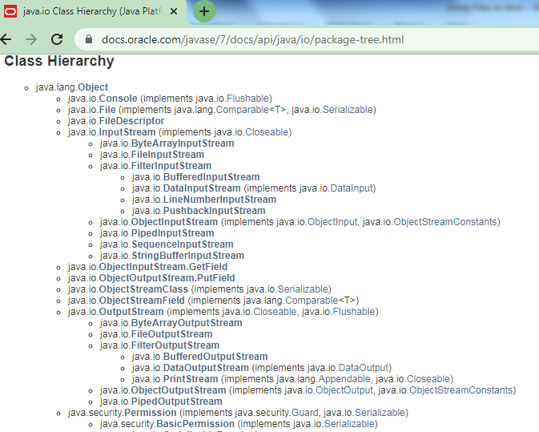

Slide 6
I/O Overview
I/O = Input/Output
In this context it is input to and output from programs
Input can be from keyboard or a file
Output can be to a display (screen) or to a file
Advantages of File I/O
permanent copy (Preserves copy of your data)
Significance of File I/O:
output from one program can be input to another
input can be automated (rather than entered manually)

Slide 7
Java I/O Intro
Java does provide strong, flexible support for I/O as it relates to files and networks
Java’s I/O system is cohesive and consistent, and once you understand its fundamentals, the rest of the I/O system is easy to master

Slide 8
JAVA I/O for a Program
Program Data is retrieved from an input source
Program Results are sent to an output destination
Java sources / destinations are defined very broadly
E.g. N/w Connection, Memory Buffer, Disk File … all can be manipulated by Java I/O classes
Physically different devices are handled in Java by the same abstraction: the stream.

Slide 9
Streams
Java programs perform I/O through STREAMS
A stream is an abstraction that either produces or consumes information.

Slide 10
Java I/O Stream
An I/O stream, is a logical entity that either produces or consumes information.
An I/O stream is linked to a physical device by the Java I/O system.
All I/O streams behave in the same manner, even if the actual physical devices they are linked to differ.
Thus, the same I/O classes and methods can be applied to different types of devices.

Slide 11
…contd.. Java I/O Stream
This means that an input stream can abstract many different kinds of input: from a disk file, a keyboard, or a network socket.
Likewise, an output stream may refer to the console, a disk file, or a network connection.
Streams are a clean way to deal with input/output without having every part of your code understand the difference between a keyboard and a network, for example.
Java implements streams within class hierarchies defined in the java.io package.

Slide 12
Streams
Stream: an object that either delivers data to its destination (screen, file, etc.) or that takes data from a source (keyboard, file, etc.)
it acts as a buffer between the data source and destination
INPUT (Source) -→ WRAP INTO STREAM OBJECT-→ OUTPUT (Destination)
Input stream: a stream that provides input to a program
System.in is an input stream (Ex. scanf, cin )
Object- Converts Human readable code to machine code
Output stream: a stream that accepts output from a program
System.out is an output stream (Ex. Printf, cout)
A stream connects a program to an I/O object (Program –HLL and I/O Object-Machine Level Language)
System.out connects a program to the screen (Ex. System.out.println)
System.in connects a program to the keyboard

Slide 13
Two types of streams: byte and character
Byte Streams and Character Streams
Byte streams provide a convenient means for handling input and output of bytes.
Byte streams are used, for example, when reading or writing binary data.
Character streams provide a convenient means for handling input and output of characters. They use Unicode and, therefore, can be internationalized.
Also, in some cases, character streams are more efficient than byte streams.
But at the lowest level, all I/O is still byte-oriented. The character-based streams simply provide a convenient and efficient means for handling characters.

Slide 14
The byte stream i/o classes in java.io

Slide 15
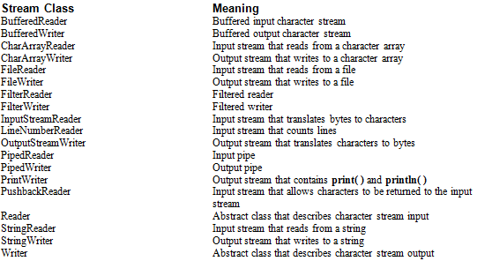
The character stream i/o classes in java.io

Slide 16
The Byte Stream Classes
Byte streams are defined by using two class hierarchies. At the top are two abstract classes:
InputStream and OutputStream.
Each of these abstract classes has several concrete subclasses that handle the differences among various devices, such as disk files, network connections, and even memory buffers.
The byte stream i/o classes in java.io are shown next

Slide 17
The byte stream i/o classes in java.io

Slide 18
Methods Of Abstract Classes InputStream, OutputStream
The abstract classes InputStream and OutputStream define several key methods that the other stream classes implement.
Two of the most important are read( ) and write( ), which, respectively, read and write bytes of data.
Each has a form that is abstract and must be overridden by derived stream classes.

Slide 19
The Character Stream Classes
Character streams are defined by using two class hierarchies.
At the top are two abstract classes: Reader and Writer.
These abstract classes handle Unicode character streams. Java has several concrete subclasses of each of these.
The character stream i/o classes in java.io are shown next

Slide 20
The character stream i/o classes in java.io

Slide 21
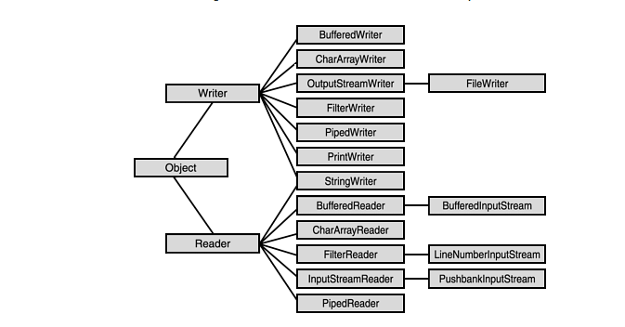
Character Streams

Slide 22
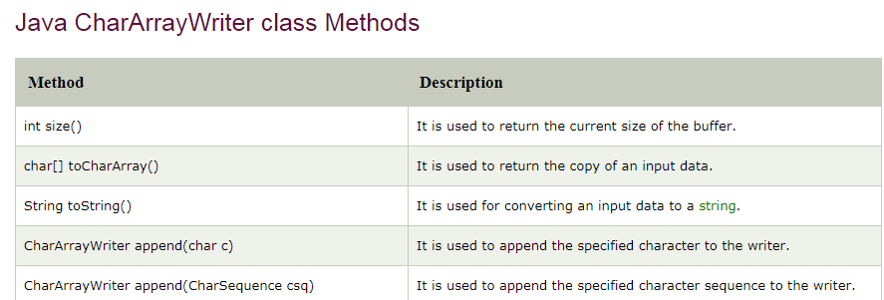
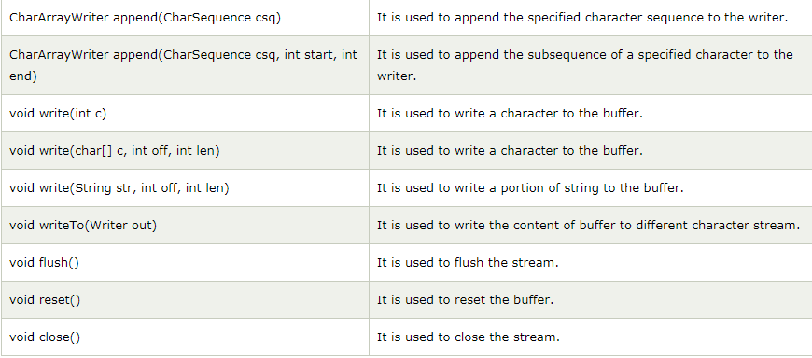
CharArrayWriter

Slide 23
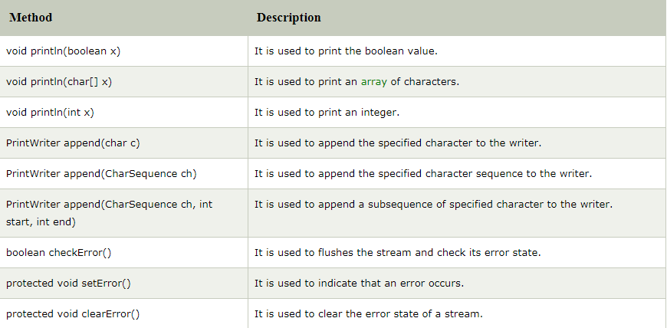
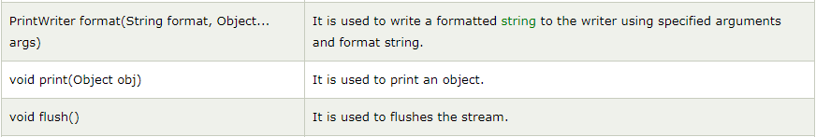
PrintWriter
used to print the formatted representation of objects to the text-output stream.

Slide 24
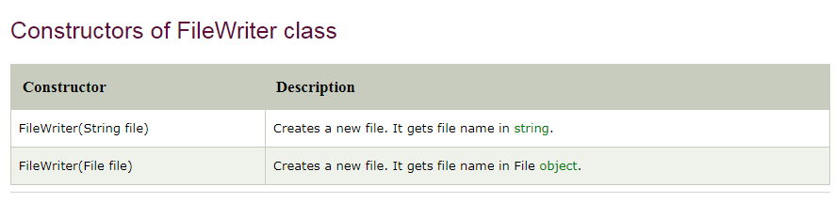
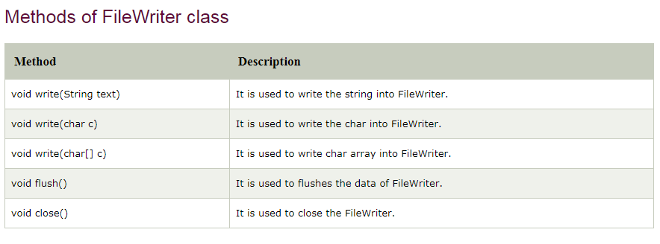
File Writer

Slide 25
The Predefined Streams
Java programs automatically import the java.lang package, which defines a class called System, which encapsulates several aspects of the run-time environment.
Example, using some of its methods, you can obtain the current time and the settings of various properties associated with the system.
System also contains three predefined stream variables: in, out, and err.
These fields are declared as public, static, and final within System.
This means that they can be used by any other part of your program and without reference to a specific System object.
System.out refers to the standard output stream. By default, this is the console.
System.in refers to standard input, which is the keyboard by default.
System.err refers to the standard error stream, which also is the console by default.
However, these streams may be redirected to any compatible I/O device.

Slide 26
…contd… The Predefined Streams
System.in is an object of type InputStream
System.out and System.err are objects of type PrintStream
These are byte streams, even though they are typically used to read and write characters from and to the console.
You can wrap these within character-based streams, if desired.

Slide 27
Using the Java I/O Classes

Slide 28
Buffering
Not buffered: each byte is read/written from/to disk as soon as possible
“little” delay for each byte
A disk operation per byte---higher overhead
Buffered: reading/writing in “chunks”
Some delay for some bytes
Assume 16-byte buffers
Reading: access the first 4 bytes, need to wait for all 16 bytes are read from disk to memory
Writing: save the first 4 bytes, need to wait for all 16 bytes before writing from memory to disk
A disk operation per a buffer of bytes---lower overhead

Slide 29
Reading Console Input

Slide 30
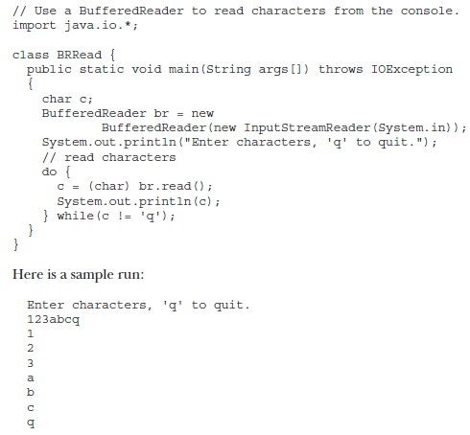

Slide 31
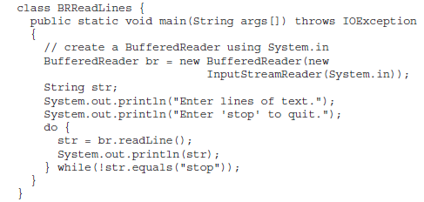
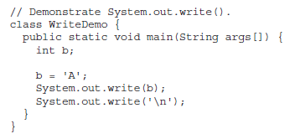

Slide 32
PrintWriter Class
For realworld programs, the recommended method of writing to the console when using Java is through a PrintWriter stream.
PrintWriter is one of the character-based classes.
Using a character-based class for console output makes internationalizing your program easier.
PrintWriter defines several constructors. One of them is:
PrintWriter(OutputStream outputStream, boolean flushingOn)
outputStream is an object of type OutputStream, and flushingOn controls whether Java
flushes the output stream every time a println( ) method (among others) is called. If
flushingOn is true, flushing automatically takes place. If false, flushing is not automatic.

Slide 33
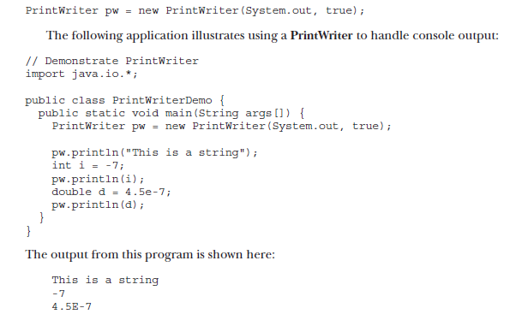

Slide 34
PRACTICE TASKS
Perform Console I-O (Int, double, string, etc) using JAVA I/O Classes.

